Slide 1
Machine Learning
BE Sixth Semester 22CS610
References
http://www.pitt.edu/~super4/34011-35001/34301.ppt
Pattern Recognition and image Analysis by Earl Gose, Johnsonbaugh and Steve Jost
Data Analytics CS40003 by Dr. Debasis Mahanta

Slide 2
Course Outcomes
After completing this course, students should be able to:
CO1: Understand the basic concepts of Machine Learning.
CO2: Formulate machine learning problems corresponding to different applications.
CO3: Understand the unsupervised learning techniques..
CO4: Understanding the pre-processing activity done for Machine learning algorithm.
CO5: Understand neural networks implemented for various applications.

Slide 3
Syllabus
Unit 1: Introduction & Bayesian Decision Theory: What Is Machine Learning? Examples of Machine Learning Applications: Learning Associations, Classification, Regression, unsupervised Learning, Reinforcement Learning. Introduction to Bayesian Decision Theory: Introduction, Classification, Losses and Risks, Discriminant Functions.

Slide 4
Unit 2: Supervised Learning: Learning a Class from Examples, Learning Multiple Classes, Regression, Model Selection and Generalization, Dimensions of Supervised Machine Learning Algorithm.
Non-Parametric Methods: Histogram Estimator, Kernel Estimator, K Nearest Neighbor Estimator.

Slide 5
Unit 3: Dimensionality Reduction: Introduction, Subset Selection, Principal Component Analysis PCA, Factor Analysis, Singular Value Decomposition and Matrix Factorization, Multidimensional Scaling, Linear Discriminant Analysis.

Slide 6
Unit 4: Clustering: Introduction, Hierarchical Clustering: Agglomerative Clustering Algorithm, The single Linkage Algorithm, The Complete Linkage Algorithm, The Average–Linkage Algorithm, Partitional Clustering: Forgy’s Algorithm, The K-Means Algorithm.

Slide 7
Unit 5: Multilayer Perceptron: The Perceptron, training a Perceptron, Learning Boolean Functions, Multilayer Perceptron, Back Propagation Algorithm, Training Procedures, Tuning Network size.

Slide 8
Text Books
1. Ethem Alpaydin (2014). Introduction to Machine Learning, Third Edition, MIT Press. The textbook website is https://www.cmpe.boun.edu.tr/~ethem/i2ml3e/
2. Pattern Recognition and Image Analysis, Earl Gose, Richard Johnsonbaugh Steve Jos, Pearson 2015.
3. Pattern Classification, Richard O. Duda, Peter E. Hart, David G. Stork, Second edition, Wiley publication.

Slide 9
Reference Books
1. Machine Learning, Tom M. Mitchell, McGraw-Hill Publishers, 1997.
2. Pattern Recognition and Machine Learning, Christopher M. Bishop, Springer Publishers, 2011.
3. Kevin Murphy, Machine Learning: A Probabilistic Perspective, MIT Press, 2012.
Understanding Machine Learning , Shai Shalev-Shwartz and Shai Bendavid, Cambridge University press. 2017.

Slide 10
Assessment Weightage in Marks
Class Test –I 15
Quiz/Mini Projects/ Assignment/ seminars 10
Class Test – II 15
Total 40

Slide 11
Question Paper Pattern
Semester End Examination (SEE)
Semester End Examination (SEE) is a written examination of three hours duration of 100 marks with 50% weightage.
Note:
• The question paper consists of TWO parts PART- A and PART- B.
• PART- A consists of Question Number 1-5 are compulsory
(ONE question from each unit)
• PART-B consists of Question Number 6-15 will have internal choice.
(TWO question from each unit)
• Each Question carries 10 marks and may consist of sub-questions.
• Answer 10 full questions of 10 marks each

Slide 12
Machine Learning

Slide 13

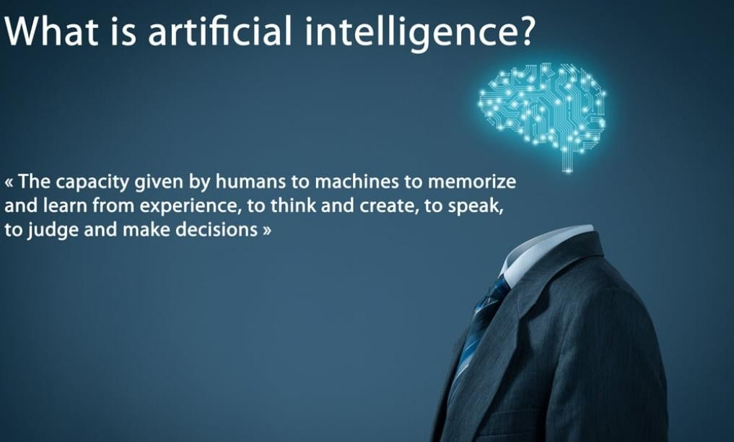

Slide 14
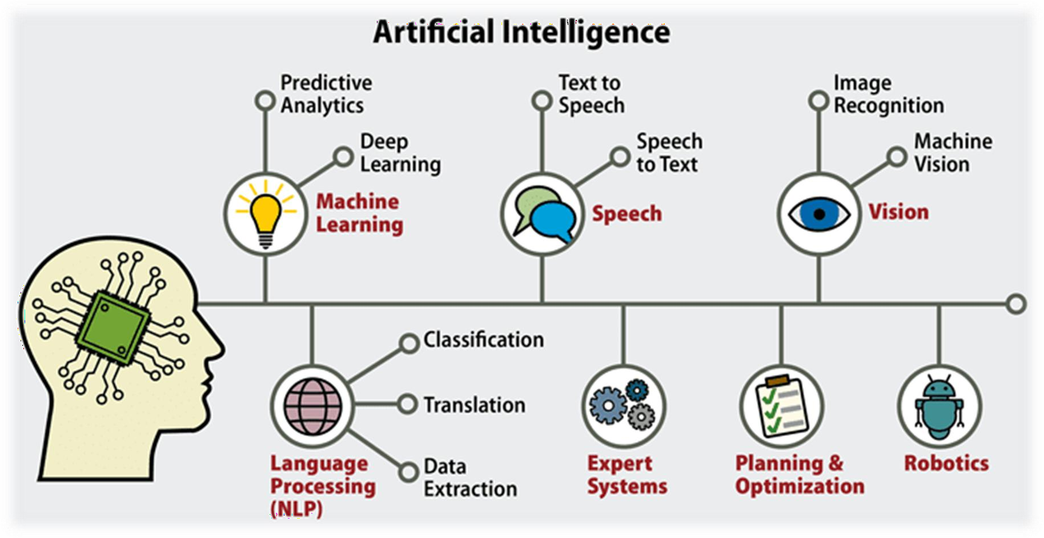

Slide 15
The simulation of Human Intelligence by Machines
Key components:
Learning
Reasoning
Problem-solving
Perception
Language understanding

Slide 16
Artificial
Intelligence
Machine
Learning
Deep Learning
Data Science

Slide 17
What is Machine Learning?
Learning : is any process by which a system improves performance from experience.
Example: We call experienced doctor, Experienced Teacher, Experienced driver
Machine Learning is the study of algorithms that
• improve their performance P
• at some task T
• with experience E.
A well-defined learning task is given by <P,T,E>

Slide 18
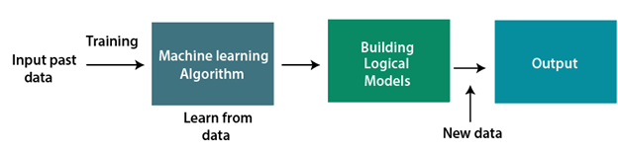
A Machine Learning system learns from historical data, builds the prediction models, and whenever it receives new data, predicts the output for it.
The accuracy of predicted output depends upon the amount of data, as the huge amount of data helps to build a better model which predicts the output more accurately.

Slide 19
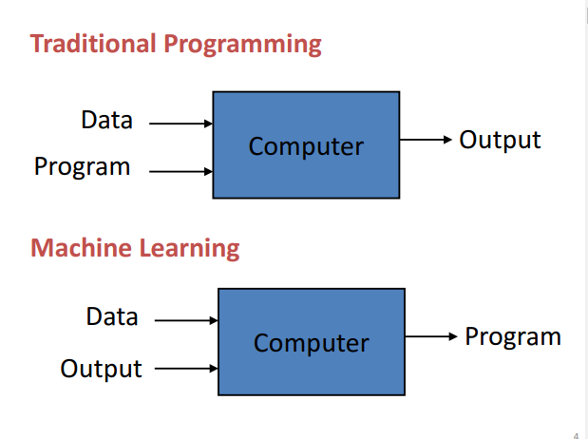
The field of study that gives computers the ability to learn without being explicitly programmed

Slide 20
What is Machine Learning?
Machine learning is a field of Computer Science and Artificial Intelligence (AI) that uses data and algorithms to make the machine learn the way humans learn.
Machine learning uses algorithms and data patterns to build a model and using the model can produce a desired output.
Through the use of data and algorithms, machines can make predictions,
recommendations, decisions as well as classifications. Some common uses of Machine learning include: Providing online recommendations,
Filtering spam emails Giving web search results.
Classify objects and assign appropriate class labels

Slide 21
Deep Learning
It is the subset of ML, which mimic human brain.
Three popular Deep Learning Techniques are:
ANN – Artificial Neural Network
CNN- Convolution Neural Network
RNN- Recurrent Neural Network

Slide 22
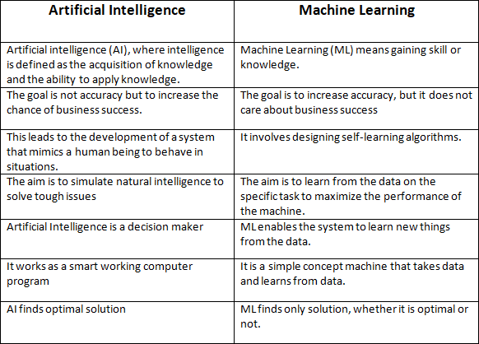

Slide 23
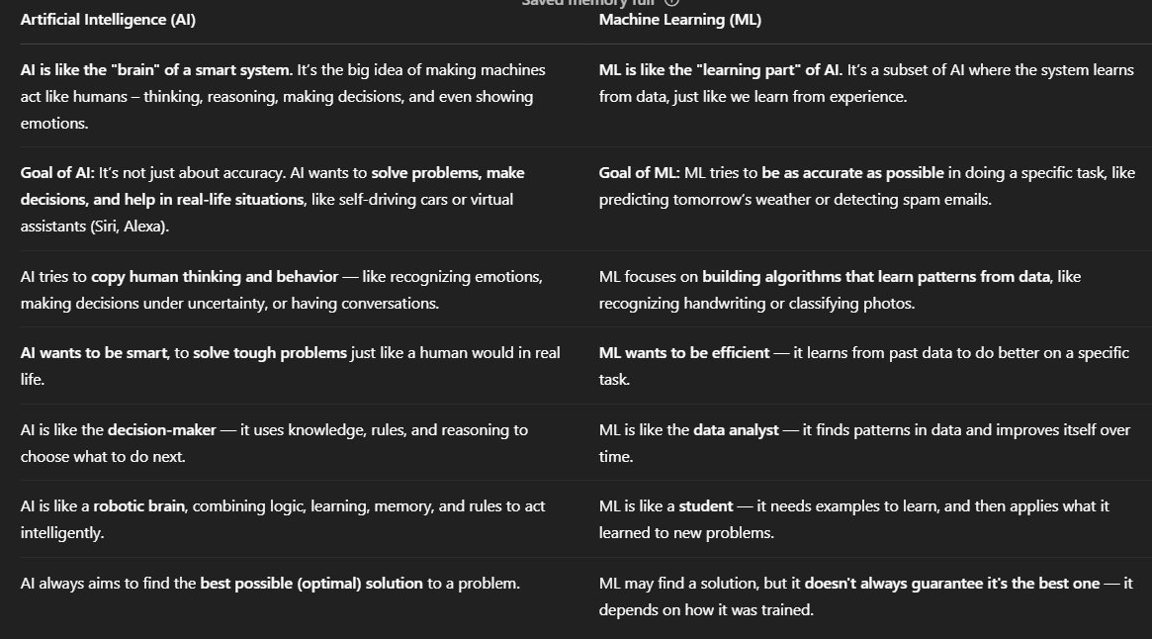

Slide 24
AI is the goal — to make machines intelligent like humans.
AI helps the car drive safely by understanding traffic rules, reading signs, avoiding people — like a human would.
ML is the method — how machines learn from data to become intelligent.
ML helps it learn from thousands of hours of driving data — so it recognizes objects like stop signs or pedestrians.

Slide 25

Features and classes
Properties or attributes used to classify the objects are called features.
A collection of “similar” (not necessarily same) objects are grouped together as one “class”.
For example:
All the above are classified as character T
Classes are identified by a label.

Slide 26
Samples or patterns
The individual items or objects or situations to be classified will be referred as samples or patterns or data.
The set of data is called “Data Set”.

Slide 27
Training and Testing data
Training set : 70 to 80% of the available data will be used for training the system.
In Supervised classification Training data is the data you use to train an algorithm or machine learning model to predict the outcome you design your model to predict.
Testing set : around 20-30% will be used for testing the system. Test data is used to measure the performance, such as accuracy or efficiency, of the algorithm you are using to train the machine.
Testing is the measure of quality of your algorithm.
Many a times even after 80% testing, failures can be see during testing, reason being not good representation of the test data in the training set.

Slide 28
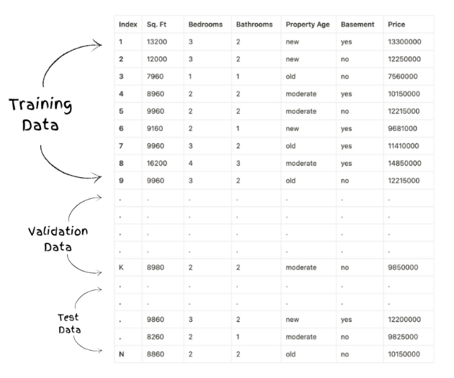
Training and Validation Data Sets

Slide 29
Model Selection?
It is the process of selecting the optimal model from the set of candidate models, for a given data.
Data used in learning:
Training Set (Usually 60%)
Validation set – Cross Validation (20%) : Validated on different models on the same training set
Test data (20%) : Unseen data
Model Selection is finding the optimal model which minimizes both bias and variance.
Bias is the error during training and Variance is the error during testing

Slide 30
Input Data and Output Response for Various Applications
Task of Classification | Input Data | Output Response
Character Recognition | Optical Signals or Strokes | Name of the character
Speech Recognition | Acoustic Waveforms | Name of the word
Speaker Recognition | Voice | Name of the speaker
Weather Prediction | Weather Maps | Weather Forecasts
Medical Diagnosis | Symptoms | Disease
Stock Market Prediction | Financial News and Charts | Predicted Market ups and Downs

Slide 31
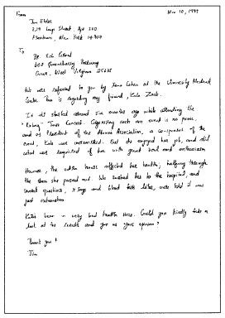
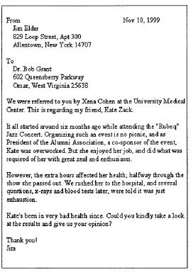
Handwriting Recognition
7

Slide 32
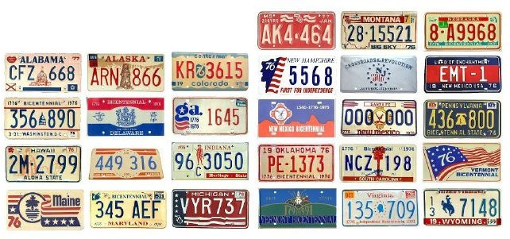
Number / Licence Plate Recognition
8

Slide 33
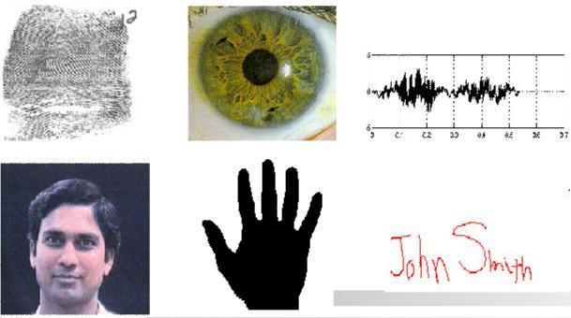
Biometric Recognition
9

Slide 34
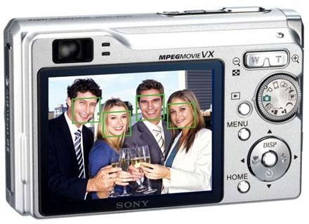
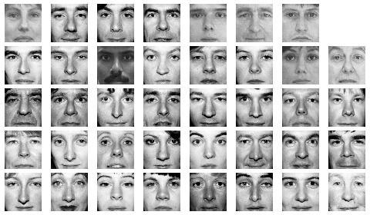
Face Detection/Recognition
Detection
Matching
Recognition
10

Slide 35
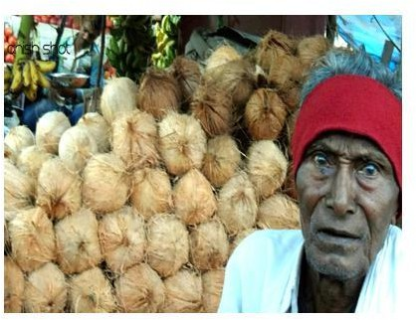


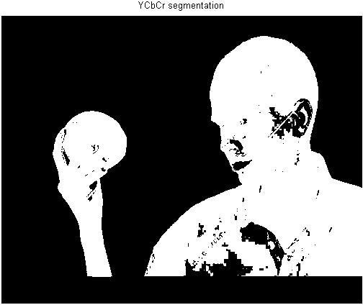

Slide 36
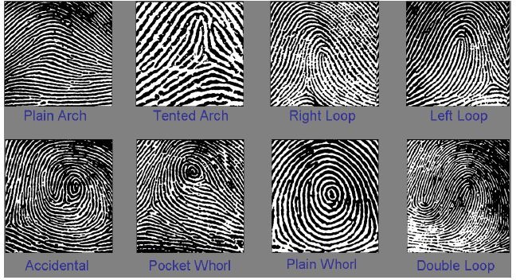
Fingerprint Classification
12

Slide 37
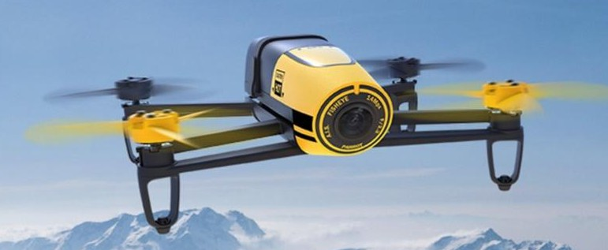

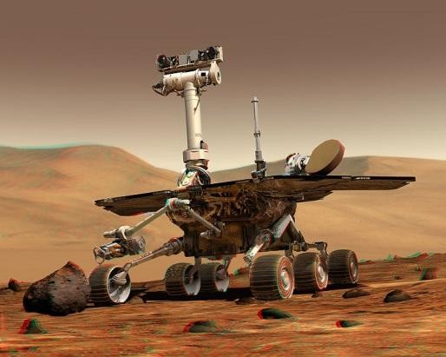
Unmanned Vehicles
Obstacle detection and avoidance Object recognition
13

Slide 38
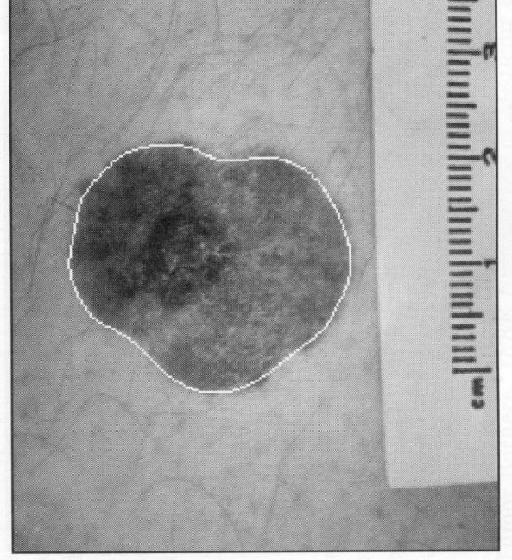
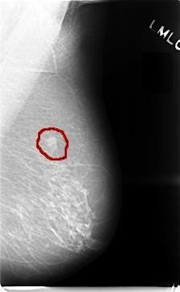
Medical Applications
Skin Cancer Detection
Breast Cancer Detection
14

Slide 39
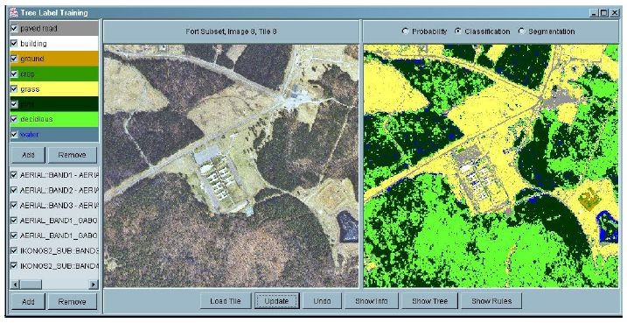
Land Cover Classification
(using aerial or satellite images)
Many applications including “precision” agriculture.
15

Slide 40
Key components of Machine Learning
Essentials in order to build effective models:
data,
algorithms,
training,
testing,
and evaluation techniques.

Slide 41
Contd…
Data is essential for model performance, decision-making, and optimization.
Features and Labels
Numerical and Categorical
Preprocessing
Cleaning, Missing Data, Outliers, removing duplicates
Scaling / Normalization
Extract features from complex structures, like texts, transactions or time series.
Exploratory Data Analysis (EDA)

Slide 42
Syllabus
Unit 1: Introduction & Bayesian Decision Theory: What Is Machine Learning? Examples of Machine Learning Applications: Learning Associations, Classification, Regression, unsupervised Learning, Reinforcement Learning. Introduction to Bayesian Decision Theory: Introduction, Classification, Losses and Risks, Discriminant Functions.

Slide 43
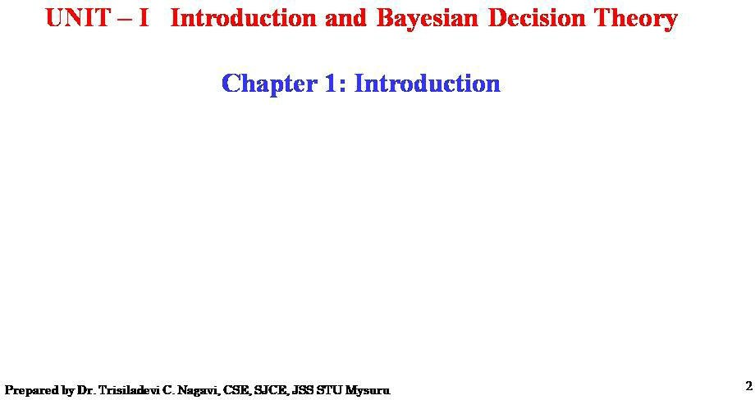

Slide 44
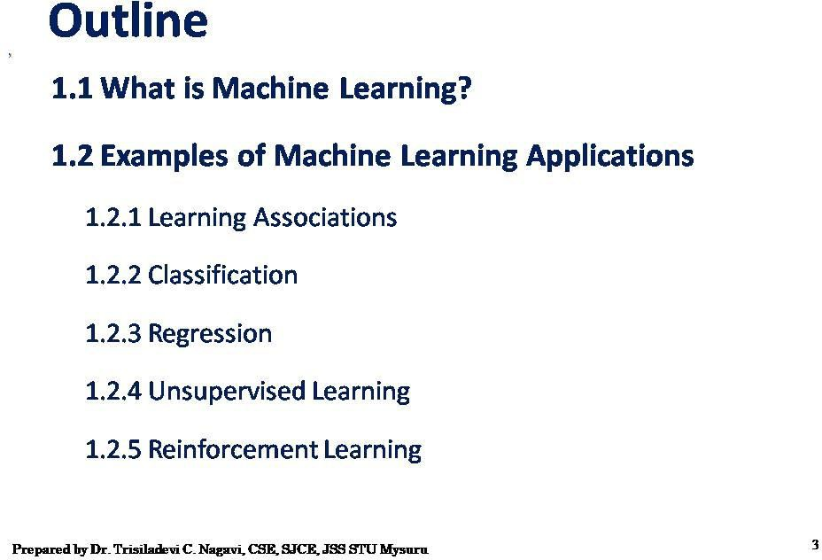

Slide 45
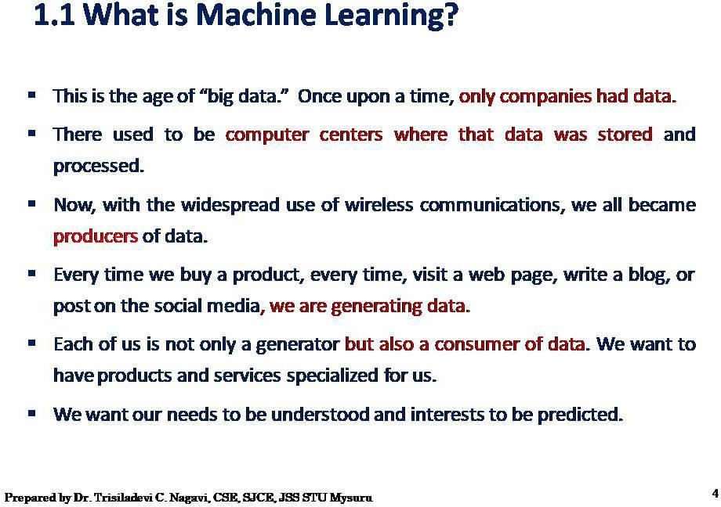

Slide 46
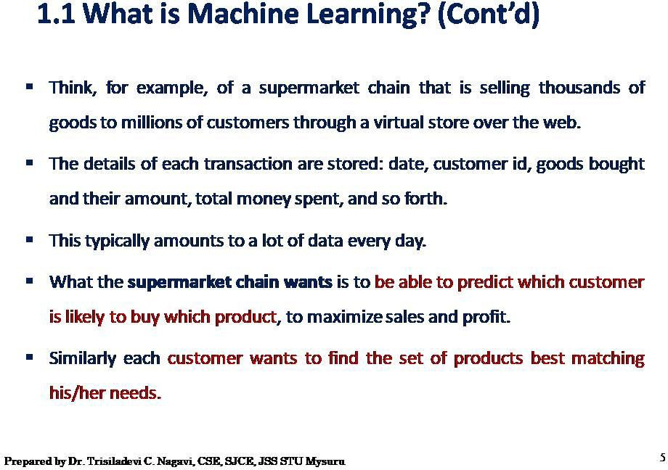

Slide 47
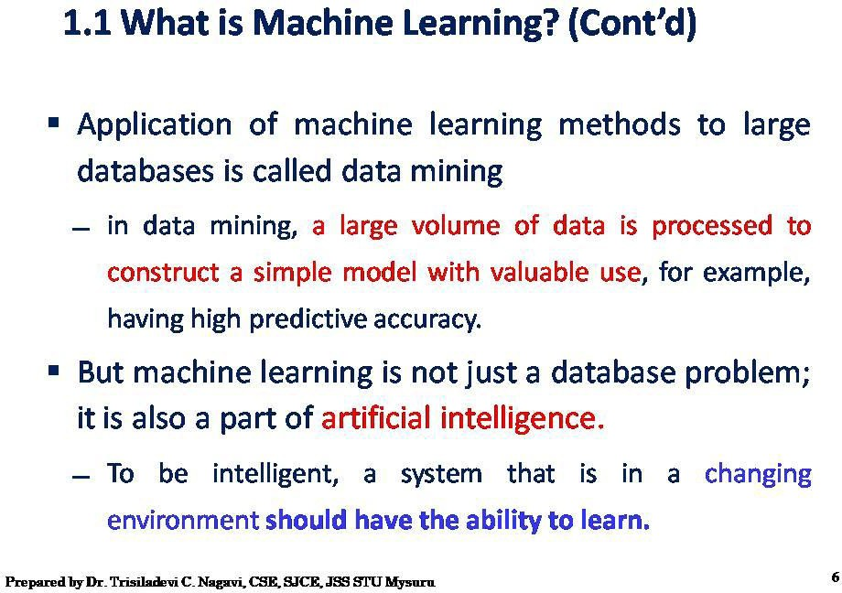

Slide 48
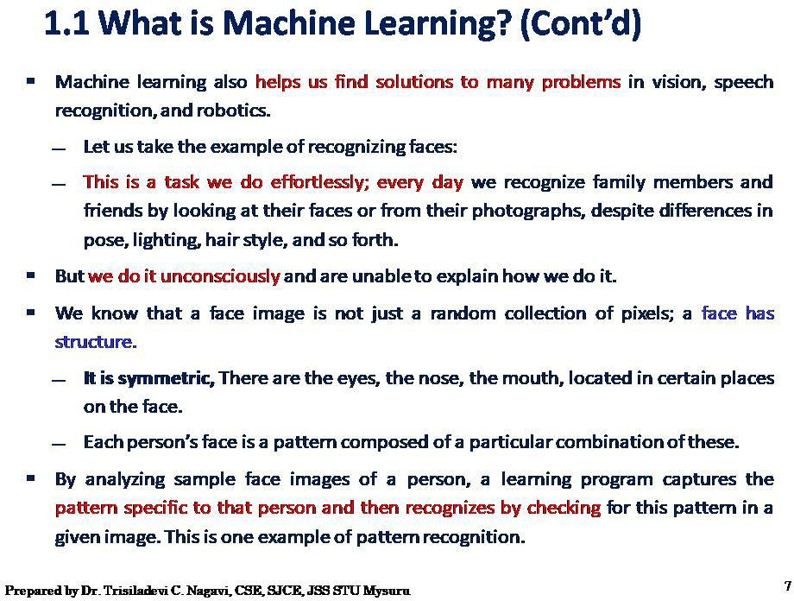

Slide 49
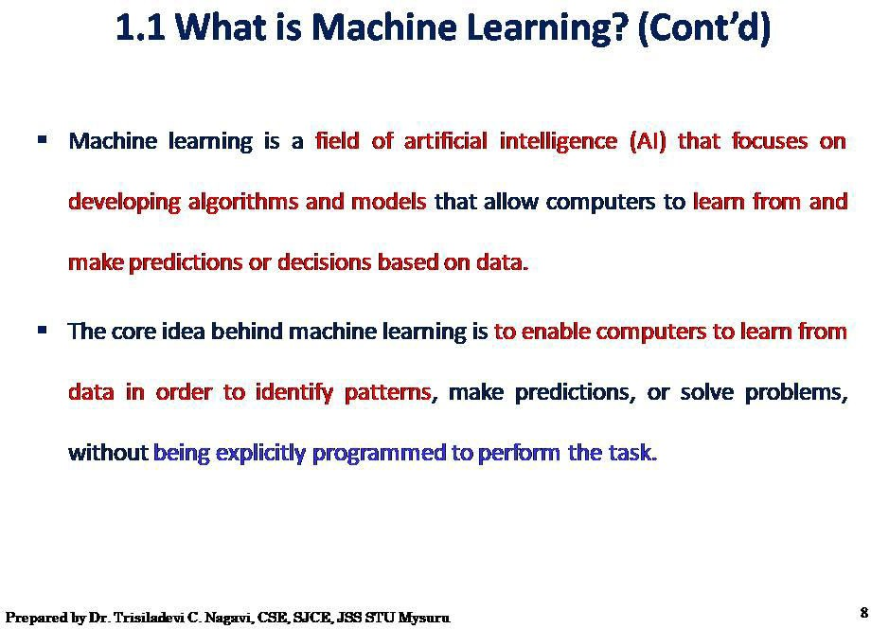

Slide 50
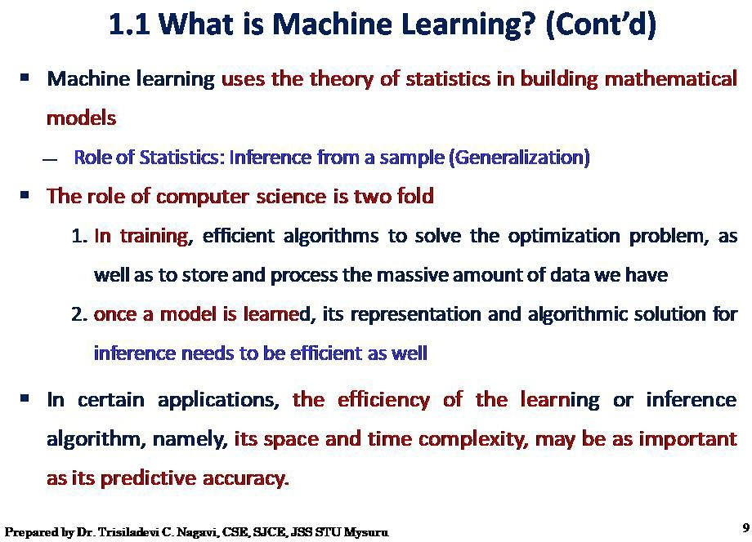

Slide 51
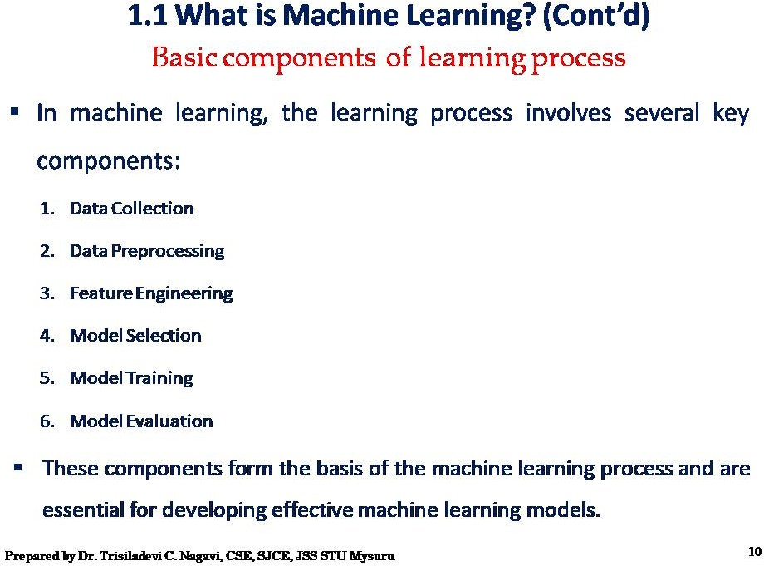

Slide 52
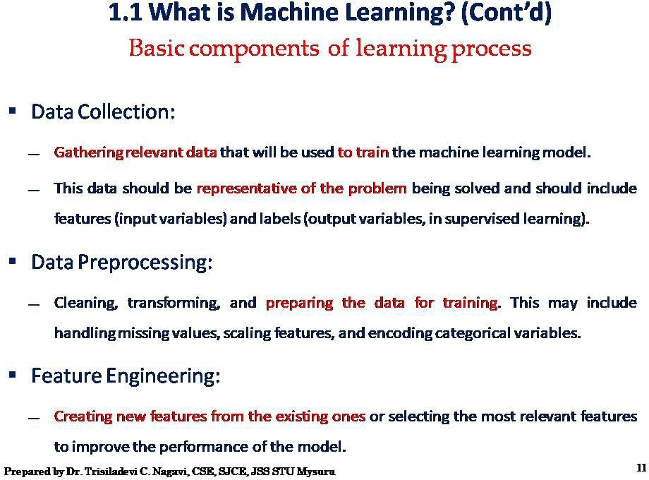

Slide 53
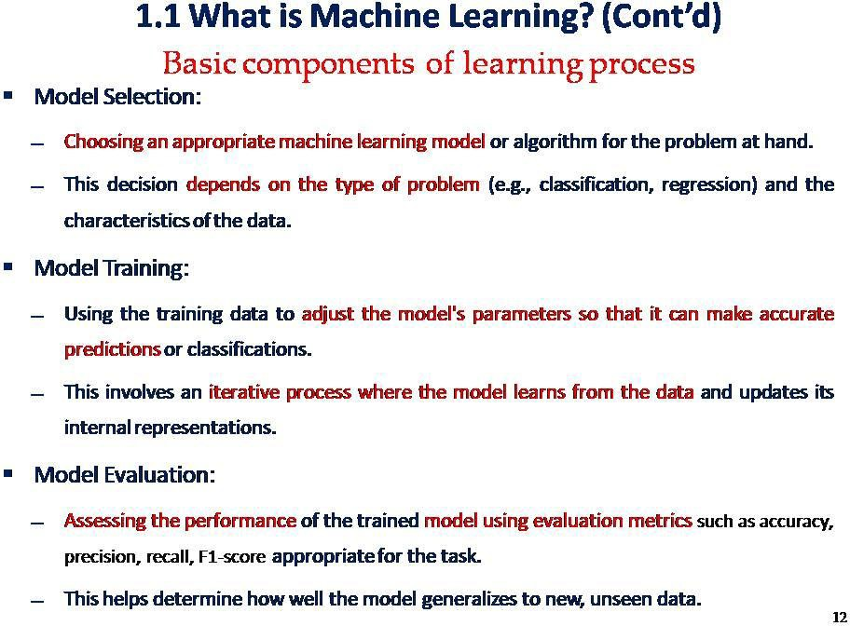

Slide 54
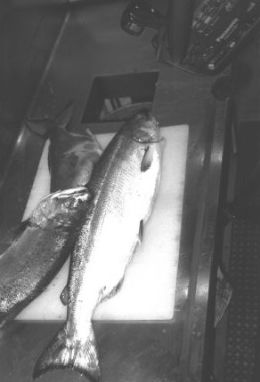
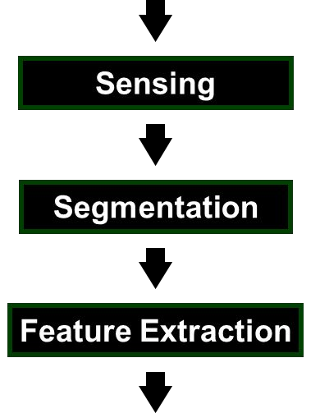
Image Processing Example
Sorting Fish: incoming fish are sorted according to species using optical sensing (sea bass or salmon?)
Problem Analysis:
set up a camera and take some sample images to extract features
Consider features such as length, lightness, width, number and shape of fins, position of mouth, etc.

Slide 55
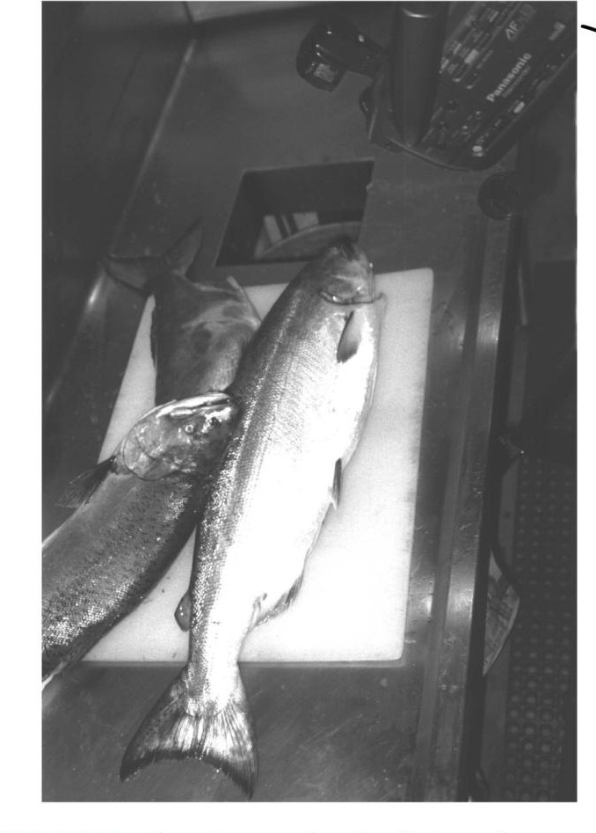
Preprocessing
A critical step for reliable feature extraction!
Examples:
Noise removal
Image enhancement
Separate touching or occluding fish
Extract boundary of each fish
32

Slide 56
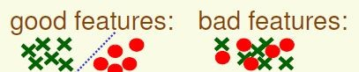
Feature Extraction
How to choose a good set of features?
– Discriminative features
– Invariant features (e.g., invariant to geometric transformations such as translation, rotation and scale)
Are there ways to automatically learn which features are best ?
33

Slide 57
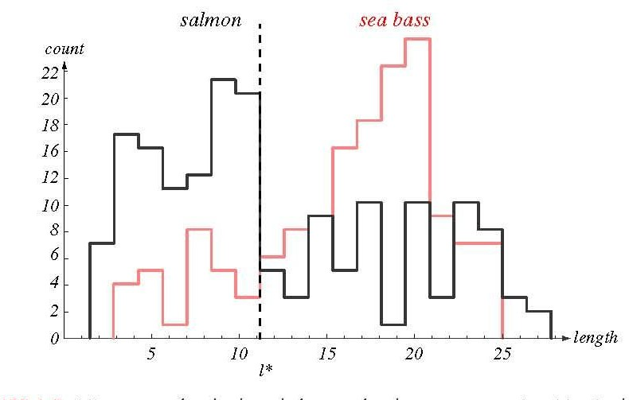
Feature Extraction (cont’d)
Histogram of “length”
threshold l*
Even though sea bass is longer than salmon on the average, there are many examples of fish where this observation does not hold.
34

Slide 58
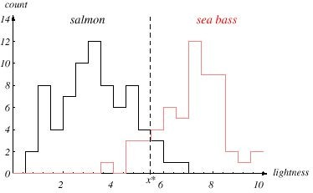
Add Another Feature
Lightness is a better feature than length because it reduces the misclassification error. Can we combine features in such a way that we improve performance?
(Hint: correlation)

Slide 59
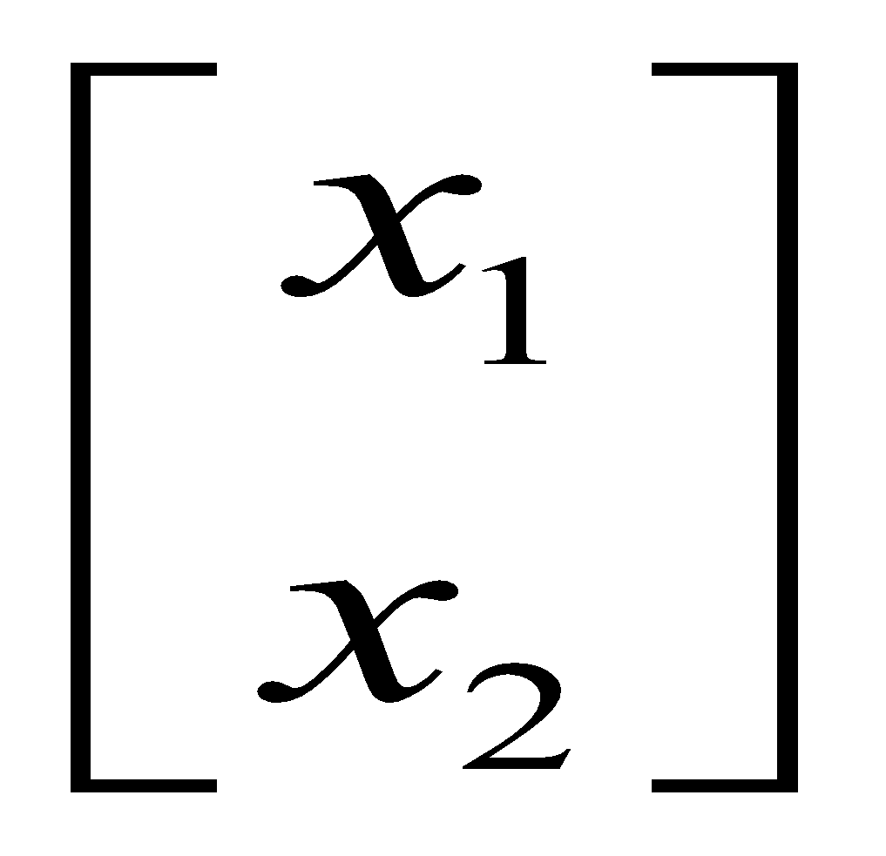
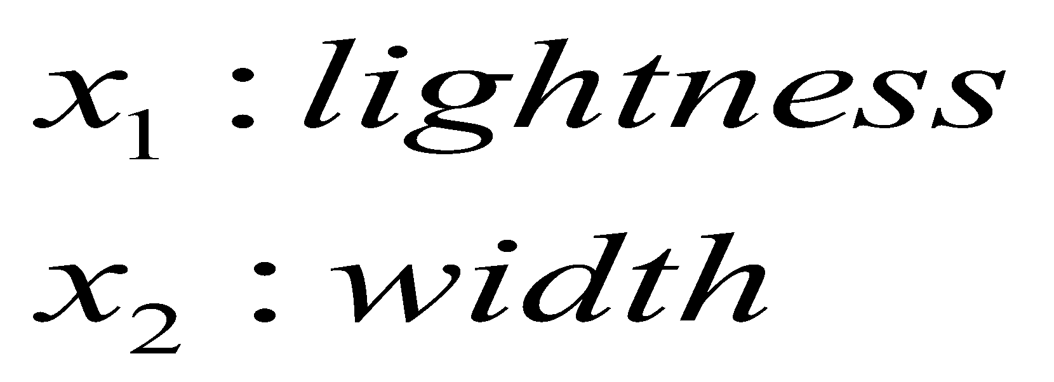
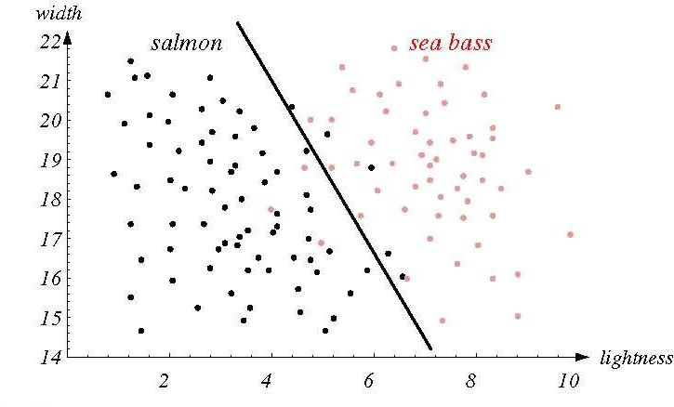
Multiple Features
To improve recognition accuracy, we might need to use more than one features.
Single features might not yield the best performance.
Using combinations of features might yield better performance.
Let us consider the scatterplot of lightness Vs Width. A graph in which the values of two variables are plotted along two axes, the pattern of the resulting points revealing any correlation present.
36

Slide 60
Decision region and Decision Boundary
Our goal of machine learning is to use an optimal decision rule to categorize the incoming data into their respective categories
The decision boundary separates points belonging to one class from points of other
The decision boundary partitions the feature space into decision regions.
The nature of the decision boundary is decided by the discriminant function which is used for decision. It is a function of the feature vector.
A linear relationship creates a straight line when plotted on a graph, a nonlinear relationship does not create a straight line but instead creates a curve.

Slide 61
Hyper planes and Hyper surfaces
For two category case, a positive value of discriminant function decides class 1 and a negative value decides the other.
If the number of dimensions is three. Then the decision boundary will be a plane or a 3-D surface. The decision regions become semi-infinite volumes
If the number of dimensions increases to more than three, then the decision boundary becomes a hyper-plane or a hyper-surface. The decision regions become semi-infinite hyperspaces.

Slide 62
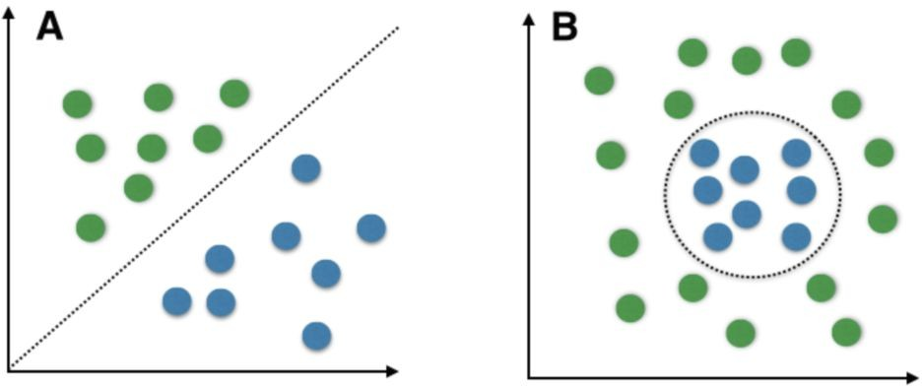
If the feature space cannot be perfectly separated by a straight line, a more complex boundary might be used. (non-linear)
Alternatively a simple decision boundary such as straight line might be used even if it did not perfectly separate the classes, provided that the error rates were acceptably low.
Linear Decision Non-Linear Decision Boundaries

Slide 63
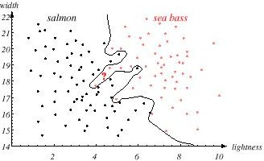
Decision Boundary for Type1 Vs Type2 Fish

Slide 64
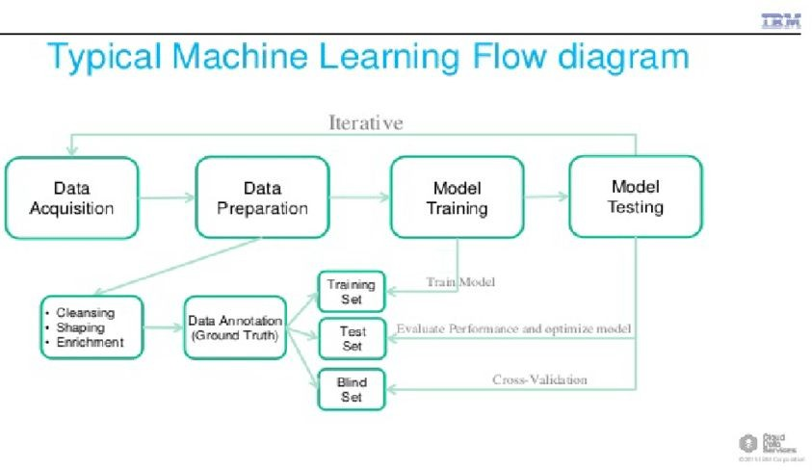

Slide 65
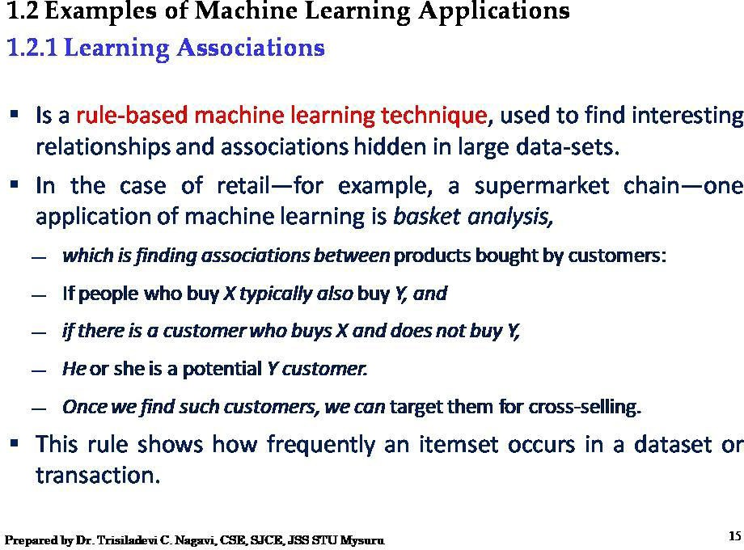

Slide 66
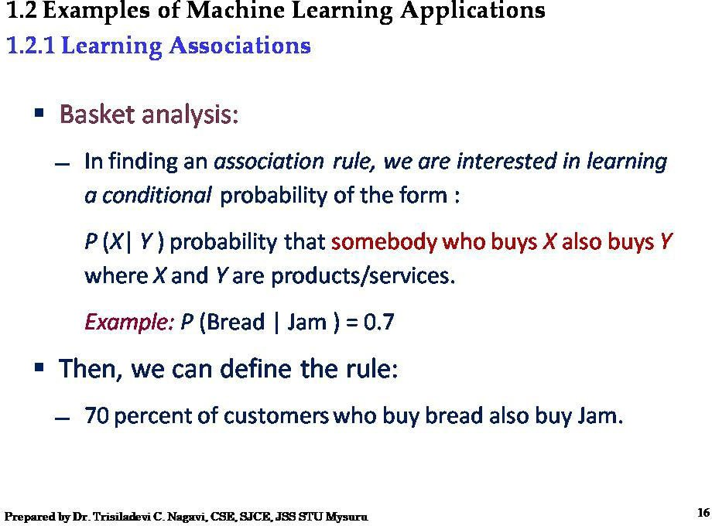

Slide 67
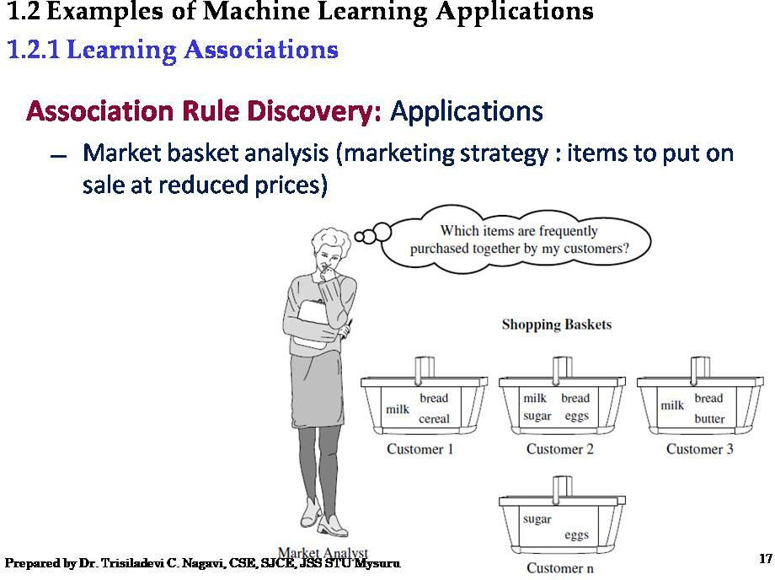
Customer n

Slide 68
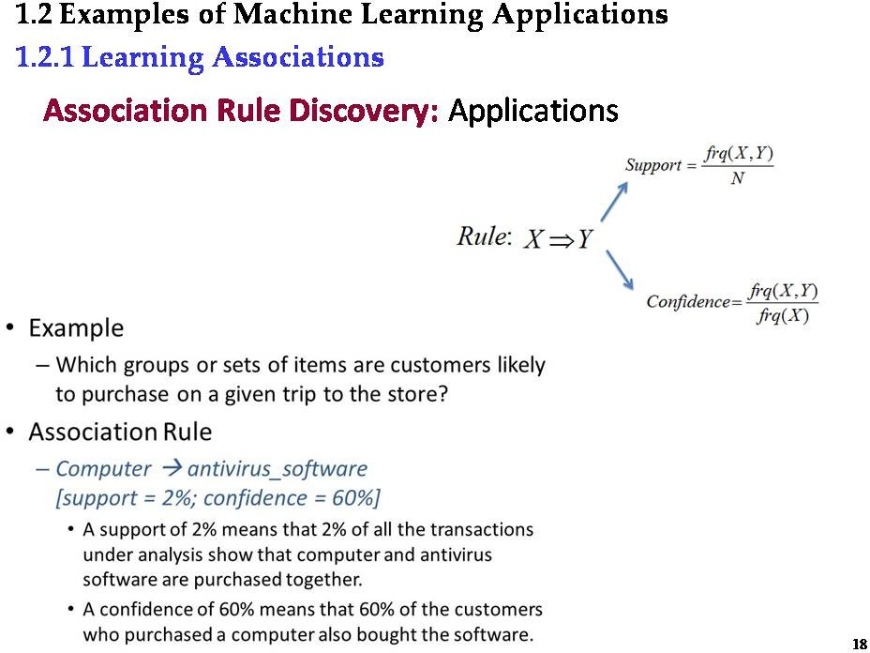

Slide 69
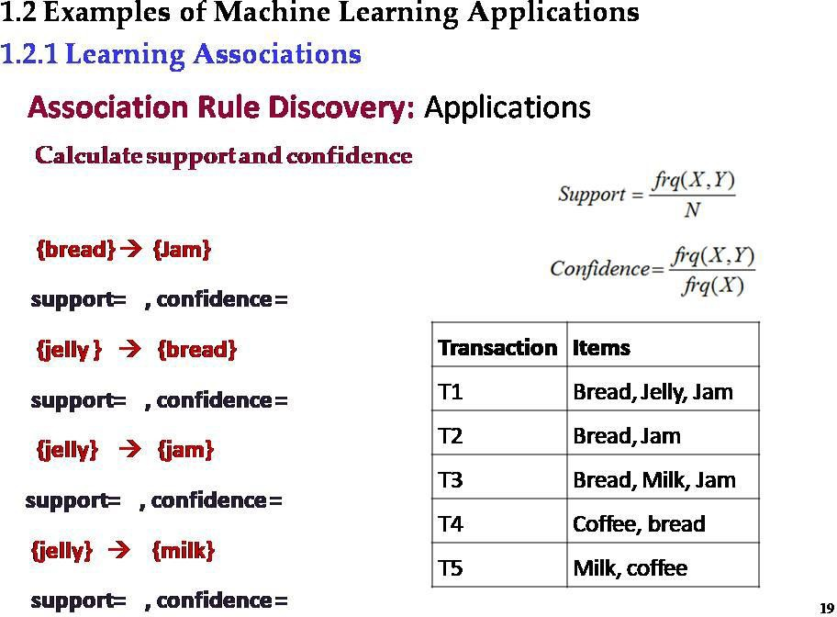

Slide 70
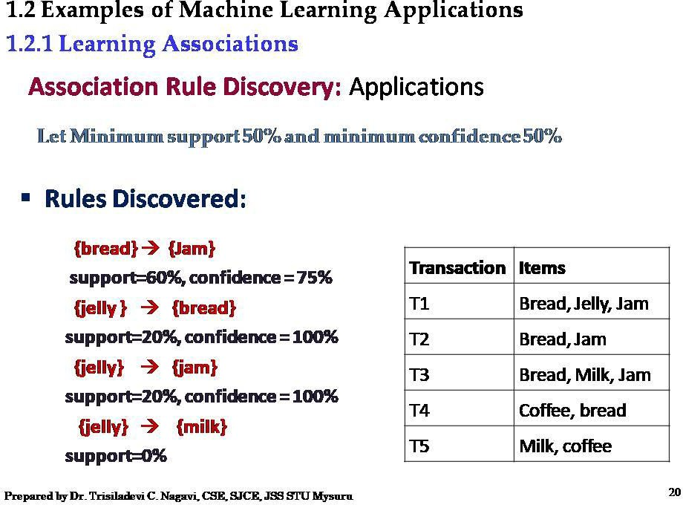

Slide 71
Types of Machine Learning:
Supervised Learning
Unsupervised Learning
Semi supervised Learning
Reinforcement Learning

Slide 72
There are four categories of learning.
Supervised learning makes use of a set of examples which already have the class labels assigned to them.
Unsupervised learning attempts to find inherent structures in the data.
Reinforcement learning uses a trial-and-error method to improve and learn from new situations.
Semi-supervised learning makes use of a small number of labeled data and a large number of unlabeled data to learn the classifier.
Classification is the task of assigning a class label to an input pattern. The class label indicates one of a given set of classes. The classification is carried out with the help of a model obtained using a learning procedure. Model is built according to the type of learning used.

Slide 73
Supervised learning: (classification) is seen as supervised learning from labeled examples.
Supervision: The data (observations, measurements, etc.) are labeled with pre-defined classes. It is like that a “teacher” gives the classes (supervision).
Test data are classified into different classes.
Unsupervised learning (clustering)
Class labels of the data are unknown
Given a set of data, the task is to establish the existence of classes or clusters in the data

Slide 74


Slide 75


Slide 76


Slide 77

In classification tasks, the output value is a category with a finite number of options.
For example, the sentiment analysis model, you can automatically classify data as positive, negative, or neutral.
Logistic regression,Support vector machines (SVM),Decision trees, Neural networks, Naive Bayes, Nearest neighbor, Gradient boosted trees, Random forest are few algorithms.
In regression tasks, the expected result is a continuous number.
This model is used to predict quantities, such as the probability an event will happen, meaning the output may have any number value within a certain range.
For example ,predicting the value of a property in a specific neighborhood or the spread of COVID19 in a particular region are examples of regression problems.
Linear regression, Ridge regression, Lasso regression are few algorithms.

Slide 78

Regression vs classification

Slide 79


Slide 80


Slide 81


Slide 82


Slide 83


Slide 84


Slide 85


Slide 86


Slide 87


Slide 88


Slide 89


Slide 90


Slide 91


Slide 92


Slide 93


Slide 94


Slide 95


Slide 96


Slide 97


Slide 98


Slide 99


Slide 100


Slide 101


Slide 102


Slide 103


Slide 104


Slide 105


Slide 106


Slide 107


Slide 108


Slide 109


Slide 110


Slide 111

Supervised vs. unsupervised learning

Slide 112


Slide 113


Slide 114




Slide 115


Slide 116


Slide 117
Semi-supervised learning
Semi-supervised learning uses a limited set of labeled data to train itself in shaping the requirements of an operation.
This learning combines a small amount of labeled data with a large volume of unlabeled data, using both supervised and unsupervised learning. It can be a cost-saving method since it involves only using a limited amount of labeled data.
To use this type of learning, train the machine with a small amount of labeled data. You then give it an unlabeled dataset to predict the outputs. These outputs are pseudo labels since they may be inaccurate.
Once you have your pseudo labels, link them with the labeled data. You also link the data inputs from the labeled data with the inputs in the unlabeled data. Finally, train the model with the label data to minimize errors and improve the model's accuracy.

Slide 118


Slide 119
Some semi-supervised learning algorithms include:
Self-trained Naive Bayes classifier
Generative adversarial networks (GAN)
General architecture for text engineering (GATE)
Semi-supervised learning helps businesses complete tasks such as:
Classifying and locating a large amount of labeled text documents
Manipulating and labeling audio and videos
Processing natural language
Ranking the relevance of web pages on a search engine site

Slide 120

Summarization of ML
ML Process

Slide 121


Slide 122


Slide 123


Slide 124


Slide 125


Slide 126


Slide 127


Slide 128


Slide 129


Slide 130


Slide 131


Slide 132


Slide 133


Slide 134


Slide 135


Slide 136


Slide 137


Slide 138


Slide 139



Bayes Theorem
This refers to choosing the most likely class, given the value of feature/s. The probabilities of class membership is calculated from Bayes Theorem.
Revisiting conditional probability
Suppose that we are interested in computing the probability of event A and we have been told event B has occurred.
Then the conditional probability of A given B is defined to be:
Similarly,
P[B|A] =
if P[A] is not equal to 0

Slide 140
From the previous two expressions
P[A ∩ B] = P[B].P[A|B]
and P[A ∩ B] = P[A].P[B|A]
This can also be used to calculate P[A ∩ B]
The Multiplication Rule
In many of the cases, P(A) may not depend on whether B has occurred. We say that the event A is independent of B if P(A) = P(A|B).
An important consequence of the definition of independence is multiplication rule, which is obtained by substituting P(A) for P(A|B) in the above expressions
P[A ∩ B] = P[A].P[B] whenever A is independent of B

Slide 141

Original Sample space is the red coloured rectangular box.
What is the probability of A occurring given sample space as B.
Hence P(B) is in the denominator.
And area in question is the intersection of A and B

Slide 142



Slide 143

Bayes rule
Likelihood
Prior
Posterior
Evidence
How good are our parameters given the data
Prior knowledge is incorporated and used to update our beliefs about the parameters

Slide 144


Slide 145
Define the terms:
P(wi) - Prior Prob. for class wi ;
P(X) - Prob. (Uncondl.) for feature vector X.
P(wi |X) - Measured-conditioned or posteriori probability
P(X | wi) - Prob. (Class-Condnl.) of feature vector X in class w
There are four parts to Bayes’ Theorem: Prior,
Evidence, Likelihood, and Posterior.

Slide 146

•

Slide 147
Class Conditional Probabilities
It represents the probability of how likely a feature x occurs given that
it belongs to the particular class. It is denoted by, particular feature.
Sometimes, it is also known as the Likelihood.
P(X|A) where x is a
It is the quantity that we have to evaluate while training the data.
During the training process, we have input(features) X labeled to corresponding class w and we figure out the likelihood of occurrence of that set of features given the class label.

Slide 148

Evidence
It is the probability of occurrence of a particular feature i.e. P(X).
It can be calculated using the chain rule as, P(X) = Σ p(X | w ) P(w )
i i i
As we need the likelihood of class conditional probability is also figure out evidence values during training.
The best way to describe the evidence, P(x), is through the law of total probability.
This law states that if you have mutually exclusive events (e.g. ω1 and ω2) whose probability of occurrence sum up to 1, then the probability of some feature is the likelihood times the prior summed across all mutually exclusive events.

Slide 149


Slide 150


Slide 151
•

Slide 152
Total Population =1000. Thus, people having cold = 10.
People having both fever and cold = 4.
Thus, people having only cold = 10 – 4 = 6.
People having fever (with and without cold) = 0.02 * 1000 = 20.
People having fever without cold = 20 – 4 = 16 (may use this later). So, probability (percentage) of people having cold along with fever, out of all those having fever, is:
4/20 = 0.2 (20%).

Slide 153
Venn Diagram illustrating one feature and two class problem
P(C and f) = P(C).P(f|C) = 0.004
f
C
P(f) = 0.02
P(C) = 0.01
Probability of a joint event - a sample comes from class C and has the feature value X:
P(C and X) = P(C).P(X|C) = P(X).P(C|X) = 0.01*0.4 = 0.02*0.2

Slide 154
Compute : Probability in the deck of cards (52 excluding jokers) Probability of (King/Face)

Slide 155

Example2: Two class problem
Find the probability that a king is drawn, given that face card was drawn using Bayes theorem. —--------------4/12
Compute : Probability in the deck of cards (52 excluding jokers)
Probability of (King|Face)
It is given by | P(King|Face) = | P(Face|King) * P(King)/ P(Face)
 | = | 1 * (4/52) / (12/52)
 | = | 1/3

Slide 156


Slide 157
Example-4.
A disease occurs in 0.5% of the population A diagnostic test gives a positive result in:
99% of people with the disease
5% of people without the disease (false positive)
If a person receives a positive result, What is the probability of him having the disease, given a positive result?

Slide 158


Slide 159


Slide 160


Slide 161

Generalized Bayes Theorem
Consider we have 3 classes A1, A2 and A3.
Area under Red box is the sample space
Consider they are mutually exclusive and collectively exhaustive.
Mutually exclusive means, if one event occurs then
another event cannot happen.
Collectively exhaustive means, if we combine all the probabilities, i.e P(A1), P(A2) and P(A3), it gives the sample space, i.e the total rectangular red coloured space.

Slide 162

Consider now another event B occurs over A1,A2 and A3.
Some area of B is common with A1, and A2 and A3.
It is as shown in the figure below:

Slide 163




Portion common with A1 and B is shown by:
Portion common with A2 and B is given by :
Portion common with A3 and B is given by:
Probability of B in total can be given by

Slide 164


Remember :
Equation from the previous slide:
Replacing first in the second equation in this slide, we will get:

Slide 165

Further simplified P(B)

Slide 166


Arriving at Generalized version of Bayes theorem

Slide 167
Example-5.
Given 1% of people have a certain genetic defect
90% tests positive for the gene defect(truepositives). 9.6% of the tests are false positives
If a person gets a positive test result, what are the odds they actually have the genetic defect?

Slide 168
Example-5.
Given 1% of people have a certain genetic defect
90% tests positive for the gene defect (true positives). 9.6% of the tests are false positives
If a person gets a positive test result, what are the odds they actually have the genetic defect?
A = chance of having the faulty gene. That was given in the question as 1%. That also means the probability of not having the gene (~A) is 99%.
X = A positive test result.
P(A|X) = Probability of having the gene given a positive test result.
P(X|A) = Chance of a positive test result given that the person actually has the gene = 90%. p(X|~A) = Chance of a positive test if the person doesn’t have the gene. That was given in the
question as 9.6%
Now we have all of the information we need to put into the equation:
P(A|X) = (.9 * .01) / (.9 * .01 + .096 * .99) = 0.0865 (8.65%).
The probability of having the faulty gene on the test is 8.65%.

Slide 169
Example-6
Given the following statistics, what is the probability that a woman has cancer if she has a positive mammogram result?
One percent of women over 50 have breast cancer.
Ninety percent of women who have breast cancer test positive on mammograms. Eight percent of women will have false positives.
.

Slide 170


Slide 171
Example-6
Given the following statistics, what is the probability that a woman has cancer if she has a positive mammogram result?
One percent of women over 50 have breast cancer.
Ninety percent of women who have breast cancer test positive on mammograms. Eight percent of women will have false positives.
Let women having cancer is W and Positive test result is PT.
P(W)=0.01
P(~W)=0.99
P(PT|W)=0.9
P(~PT|w)=0.08
Compute P(testing positive)
(0.9 * 0.01) / ((0.9 * 0.01) + (0.08 * 0.99) = 0.10.

Slide 172
Example-7 Box P has 2 red balls and 3 blue balls and box Q has 3 red balls and 1 blue ball. A ball is selected as follows:
(i) Select a box (ii) Choose a ball from the selected box such that each ball in the box is equally likely to be chosen. The probabilities of selecting boxes P and Q are (1/3) and (2/3), respectively.
Given that a ball selected in the above process is a red ball, the probability that it came from the
box P
Solution:
R --> Event that red ball is selected B --> Event that blue ball is selected
P --> Event that box P is selected
Q --> Event that box Q is selected We need to calculate P(P|R)?

Slide 173
P(R|P) = A red ball selected from box P
= 2/5
P(P) = 1/3
P(R) = P(P)*P(R|P) + P(Q)*P(R|Q)
= (1/3)*(2/5) + (2/3)*(3/4)
= 2/15 + 1/2
= 19/30
Putting above values in the Bayes's Formula P(P|R) = (2/5)*(1/3) / (19/30)
= 4/19

Slide 174


Slide 175
Example-8An aircraft emergency locator transmitter (ELT) is a device designed to transmit a signal in the case of a crash. The Altigauge Manufacturing Company makes 80% of the ELTs, the Bryant Company makes 15% of them, and the Chartair Company makes the other 5%.
The ELTs made by Altigauge have a 4% rate of defects, the Bryant ELTs have a 6% rate of defects, and the Chartair ELTs have a 9% rate of defects (which helps to explain why Chartair has the lowest market share).
If a randomly selected ELT is then tested and is found to be defective, find the probability that it was made by the Altigauge Manufacturing Company.

Slide 176
We need to find P(Altigauge|Defective).
P(Altigauge|Defective) = P(Defective|Altigauge) * P(Altigauge) / P(Defective)
P(Defective|Altigauge) * P(Altigauge) = 0.04*0.8 = 0.032 P(Defective) = 0.04*0.8 + 0.06*0.15 + 0.09*0.05 = 0.0455
P(Altigauge|Defective) = 0.032 / 0.0455 = 0.7032

Slide 177


Slide 178

Problem on Bayes theorem with 3 class case

Slide 179

While solving problem based on Bayes theorem, we need to split the given information carefully:
Asked is:

Slide 180



Note, the flip of what is asked will be always given:
It is found in the following statement :

Slide 181

What else is given:
Represented by:

Slide 182

So.. Given Problem can be represented as:

Slide 183


Slide 184
Independence
Independent random variables: Two random variables X and Y are said to be statistically independent if and only if :
p(x,y) = p(x).p(y)
Ex: Tossing two coins… are independent.
Then the joint probability of these two will be product of their probability.
Conditional Independence
Two random variables X and Y are said to be independent given Z if and only if
P(x,y|z)=P(x|z).P(y|z) : indicates that X and Y are independent given Z.

Slide 185

Conditional Independence
Event A and B are conditionally independent given C in case Pr(AB|C)=Pr(A|C)Pr(B|C)
A set of events {A } is conditionally independent given C in case
i

Slide 186
Naïve Bayes Classifier
It assumes that predictors in a Naïve Bayes model are conditionally independent, or unrelated to any of the other feature in the model. It also assumes that all features contribute equally to the outcome.
Naïve based classifier is very popular for document classifier
(naïve means: all are equal and independent: all the attributes will have equal weightage and are independent)

Slide 187

Approach:
– compute the posterior probability P(C | A , A , …, A ) for all values of C using the Bayes
theorem
1 2 n
– Choose value of C that maximizes
P(C | A , A , …, A )
1 2 n
– Equivalent to choosing value of C that maximizes
P(A , A , …, A |C) P(C)
1 2 n
How to estimate P(A , A , …, A | C )?
1 2 n

Slide 188


Slide 189

Example of Naïve Bayes Classifier

Slide 190


Solution
P(A|M)P(M) > P(A|N)P(N)
=> Mammals

Slide 191

Example. ‘Play Tennis’ data
Question: For the day <sunny, cool, high, strong>, what’s the play prediction?

Slide 192

Based on the examples in the table, classify the following datum x: x=(Outl=Sunny, Temp=Cool, Hum=High, Wind=strong)
That means: Play tennis or not?
Working:

Slide 193
Application of Naïve Bayes Classifier for NLP
Consider the following sentences:
S1 : The food is Delicious : Liked
S2 : The food is Bad : Not Liked
S3 : Bad food : Not Liked
Given a new sentence, whether it can be classified as liked sentence or not liked.
Given Sentence: Delicious Food

Slide 194
Remove stop words, then perform stemming
S1
S2
S3
F1 | F2 | F3 | 0utput
Food | Delicious | Bad
1 | 1 | 0 | 1
1 | 0 | 1 | 0
1 | 0 | 1 | 0

Slide 195
P(Liked | attributes) = P(Delicious | Liked) * P(Food | Liked) * P(Liked)
=(1/1) * (1/1) *(1/3) = 0.33
P(Not Liked | attributes) = P(Delicious | Not Liked) * P(Food | Not Liked) * P(Not Liked)
= (0)*(2/2)*(2/3) = 0
Hence the given sentence belongs to Liked class

Slide 196


Slide 197


Slide 198


Slide 199


Slide 200

Discriminant Functions

Slide 201

A decision rule prescribes what action to take based on observed input.
Idea Check: What is a reasonable Decision Rule if the only available information is the prior, and the cost of any incorrect classification is equal?
Decide ω1 if P(A) > P(B); otherwise decide ω2.
Decision or Classification algorithm according to Baye’s Theorem:
{A if P(X|A)P(A) > P(X|B)P(B)
{ B
Choose:
if P(X|B)P(B) > P(X|A)P(A)

Slide 202

•

Slide 203

•

Slide 204
What is our probability of error?
For the two class situation, we have
P(error|x) = { P(A|x) if we decide B
{ P(B|x) if we decide A
We can minimize the probability of error by following the posterior: Decide A if P(A|x) > P(B|x)
Probability of error becomes P(error|x) = min [P(A|x), P(B|x)]
Equivalently, Decide A if p(x|A)P(A) > p(x|B)P(B);
otherwise decide B I.e., the evidence term is not used in decision making. Conversely, if we have uniform priors, then the decision will rely exclusively on the likelihoods.
Take Home Message: Decision making relies on both the priors and the likelihoods
and Bayes Decision Rule combines them to achieve the minimum probability of error.

Slide 205


Slide 206


Slide 207


